Slide 1
Shell Bootcamp 2024 3 Reflections for Week #2
Alvia Hussain
Date : 30-Aug-2024

Slide 2

About Me
If it doesn’t challenge you,
it doesn’t change you
Please share an image / visual that best represents you

Slide 3

My learnings from this week!

Slide 4
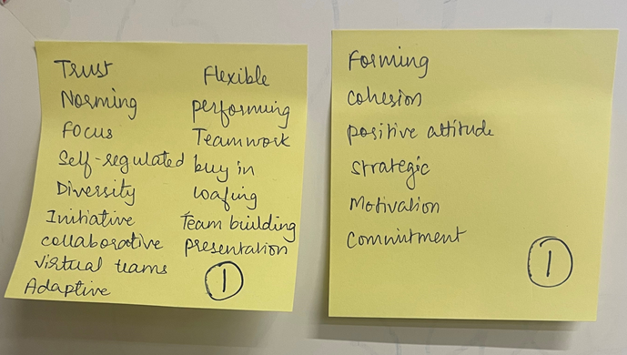
Learning 1 | My takeaways
Key Learnings: Soft Skills Training
Rapport building and interpersonal relationships and collaboration
Professional qualities- self discipline, grooming
Fixed mindset and Growth mindset
Transition from campus to corporate (C2C)
Importance of identifying PTS (potential trouble source) and SP (Suppressive person)
[Add a graphic that provides evidence of what you learned]

Slide 5
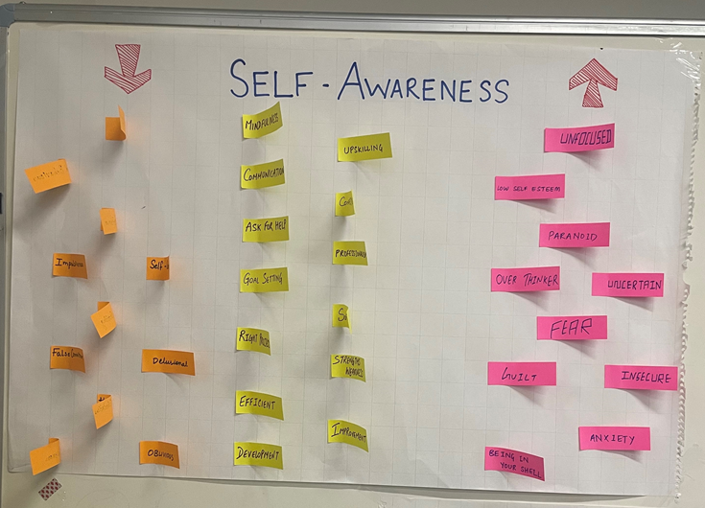
Learning 2 | My takeaways
Key Learnings: Soft Skills Training
Stakeholders- interest vs power
How to manage stakeholder expectations and increase their motivation
Skits and real time examples for practical learning
Meeting and call etiquette
Email writing as a professional
POWER: Plan, Organize, Write, Edit, Review
[Add a graphic that provides evidence of what you learned]

Slide 6
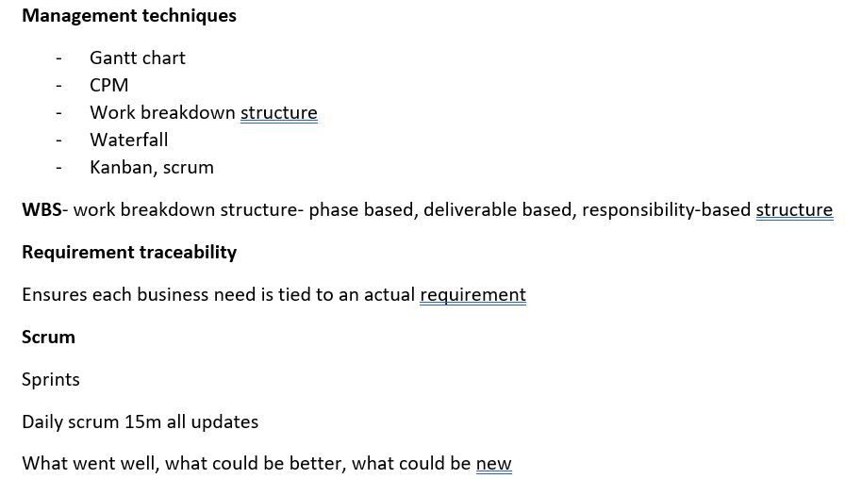
Learning 3 | My takeaways
Key Learnings: Technical Training
Business Analysis
SDLC phases
Use Case and class diagram
SCRUM and Agile
Gantt Chart, CPM, Work Breakdown Structure
Epic, Story, Task, Sub task
Agile principles
Product Backlog
[Add a graphic that provides evidence of what you learned]

Slide 7

Relevance of learnings for my organization

Slide 8

Learning 1 | Relevance for Shell
Building rapport enhances teamwork and productivity.
Professional qualities like self-discipline and grooming project a positive image.
A growth mindset drives innovation.
Supporting the transition from campus to corporate reduces turnover.
Identifying potential trouble sources and suppressive individuals helps prevent issues, maintaining a healthy work environment.
[Add a graphic that provides view of how Shell implements this learning]

Slide 9
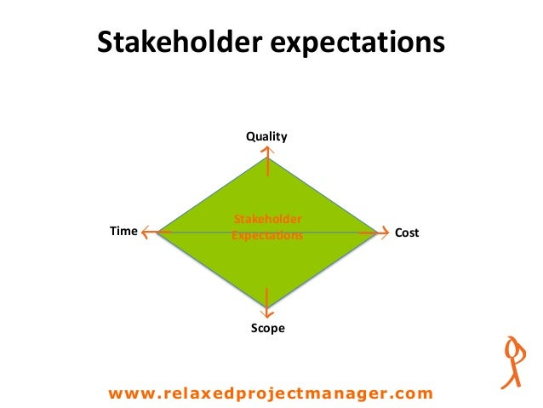
Learning 2 | Relevance for Shell
Understanding stakeholders’ interests vs. power prioritizes engagement.
Managing expectations and motivation ensures alignment.
Skits offer practical learning. Meeting and call etiquette improve communication.
Professional email writing enhances clarity.
The POWER method streamlines document creation, boosting efficiency and quality. These elements collectively foster a productive, professional, and well-aligned organization.

Slide 10
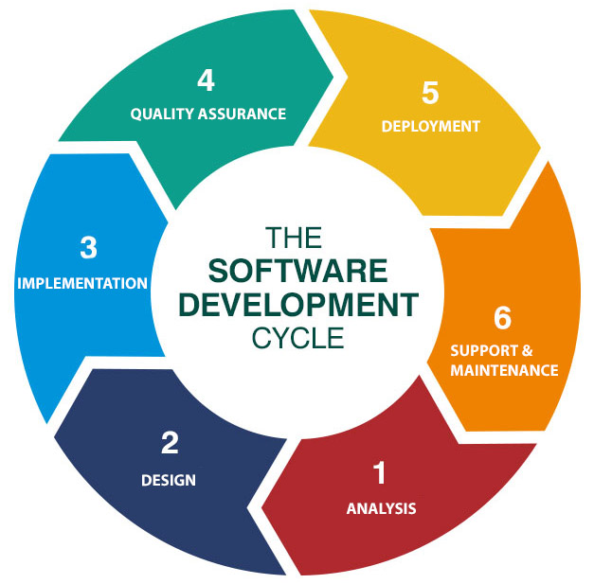
Learning 3 | Relevance for Shell
Business analysis ensures project alignment with goals.
SDLC phases provide a structured development process.
SCRUM and Agile enhance flexibility. Gantt charts, CPM, and WBS improve project management.
Epics, stories, tasks, and sub-tasks organize work. Agile principles foster adaptability.
A product backlog prioritizes tasks, ensuring efficient workflow.

Slide 11

Challenges in implementing learning

Slide 12
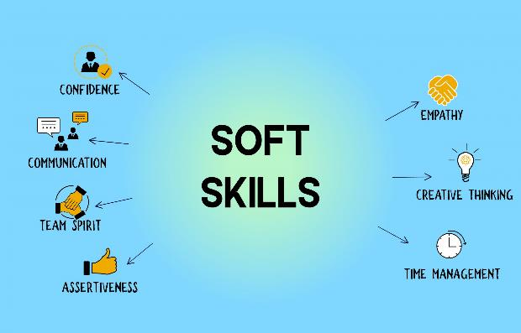
Challenge faced while implementing Learning 1
Challenges faced: Adapting to new environments, overcoming fixed mindsets, and identifying negative influences.
Overcoming them: Embracing growth mindset, fostering collaboration, and practicing self-discipline.

Slide 13

Challenge faced while implementing Learning 2
Challenges faced: Balancing stakeholder interests and power, managing expectations, and mastering professional communication.
Overcoming them: Using the POWER method for emails, practicing etiquette, and engaging in practical skits and examples.

Slide 14

Challenge faced while implementing Learning 3
Challenges faced: Understanding complex methodologies, visualizing processes, and managing detailed project components.
Overcoming them: Applying Agile principles, using visual aids like Gantt charts, and breaking down tasks into manageable parts.

Slide 15

Action Plan

Slide 16
My Action Plan for this Week
Actions
Timeline
Status
Practicing Behavioural skills, BA & Agile and DBMS
Saturday – Brush up concepts of soft skills
Sunday – BA & Agile with notes of DBMS
Status of the same by the end of the week

Slide 17

Learning is also Fun!

Slide 18
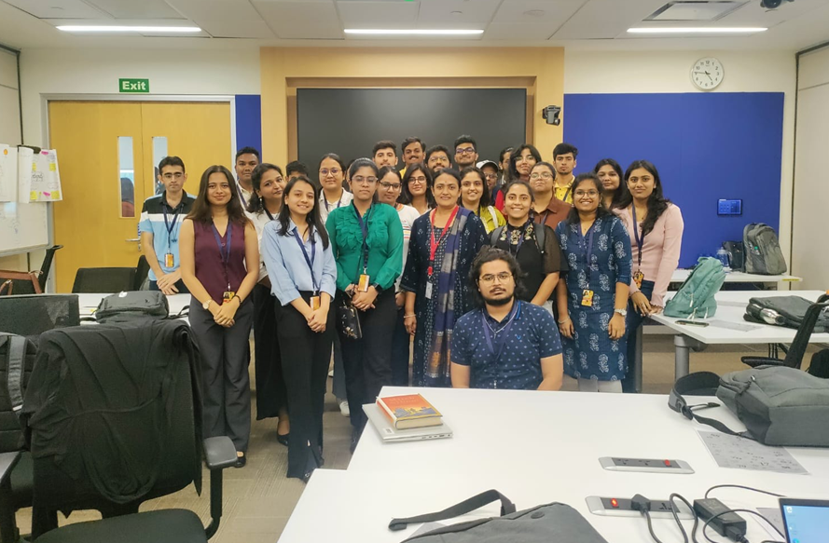
Learning is also Fun!
We practiced a lot of skits throughout the day that made public speaking very fun and comfortable.
Continuous activities made learning very fun and broke the monotonous flow

Slide 19

Summary
In conclusion, understanding and managing stakeholders, fostering effective communication, and utilizing structured methodologies like Agile and SDLC are crucial for organizational success.
Practical learning methods and professional etiquette further enhance productivity and collaboration. Together, these elements create a well-aligned, efficient, and adaptable organization, ready to meet its goals and challenges.
Revise core topics like DBMS, OS, etc.

Slide 20
Thank You

